Slide 1

Object Oriented Programming
Bayu Rimba Pratama, ST, M.Kom

Slide 2


Class, Object & Methods
- A class is a template that defines the form of an object. It specifies both the data and the code that will operate on that data
- Objects are instances of a class
- Methods are subroutines that manipulate the data defined by the class and, in many cases, provide access to that data

Slide 3
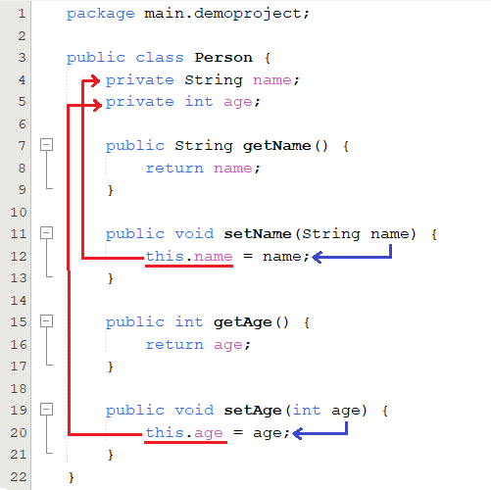
Example
To create object from Person class, just write:
Person man = new Person();
To set man’s name, write:
man.setName(“Bayu Rimba”);
To set man’s age, write:
man.setAge(37);

Slide 4
Procedural vs Object Oriented
Procedural
Object Oriented
Define new type as a Struct
Anyone have access and change any part of the struct
Everything is a variable
Define new type as a Class
We use getter/setter method to access or change its attribute
Everything is an object
Code reuse (inheritance, composition)

Slide 5
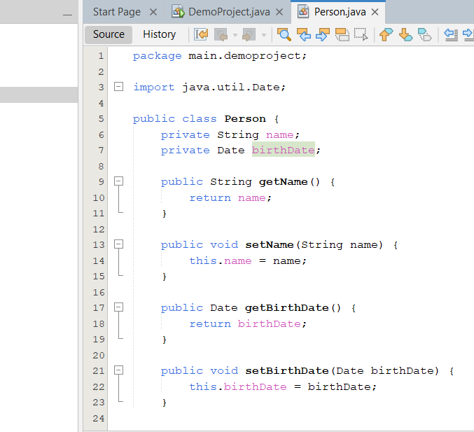
Inheritance and Polymorphism
Lets take a look again to Person Class

Slide 6
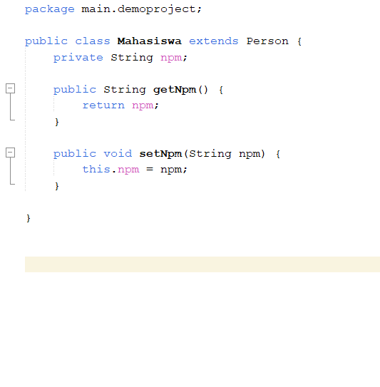
We can reuse Person class to create another
Lets says Mahasiswa is subclass of Person. Then we can create class Mahasiswa that inherit all attribute and method from Person’s class.
Note:
A class can only extend the definition of one class
Inheritance “is-a” relationship

Slide 7
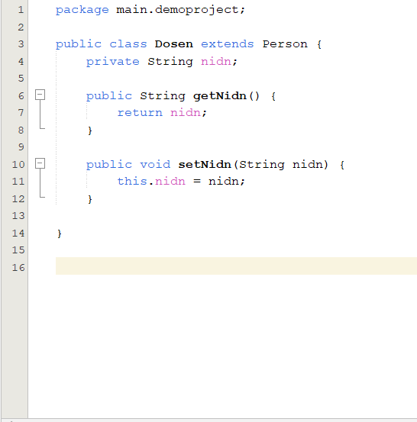
Lets create another class from Person
Lets says Dosen is also subclass of Person but, different from Mahasiswa, it have NIDN attribute.
Dosen class is also inherit all attribute and method from person class.

Slide 8
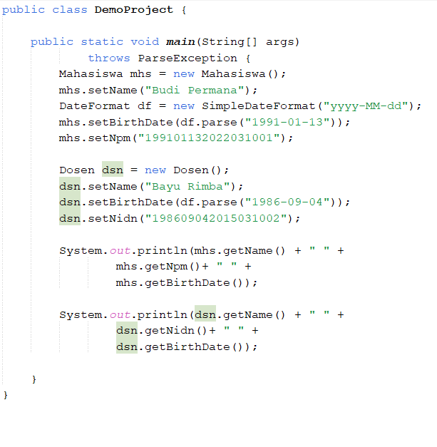
Example usage of Mahasiswa and Dosen

Slide 9
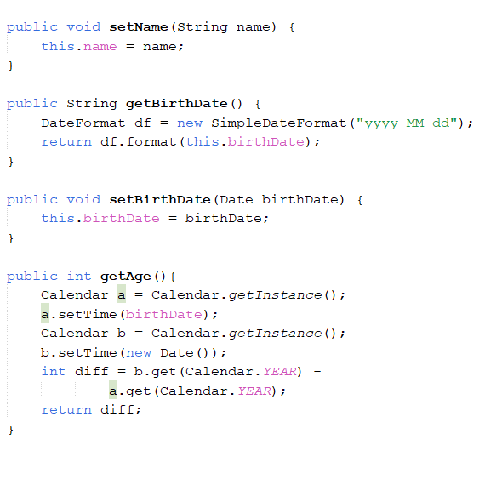
What happen if we change Person class?
All subclass of Person will get the updates. ☺

Slide 10
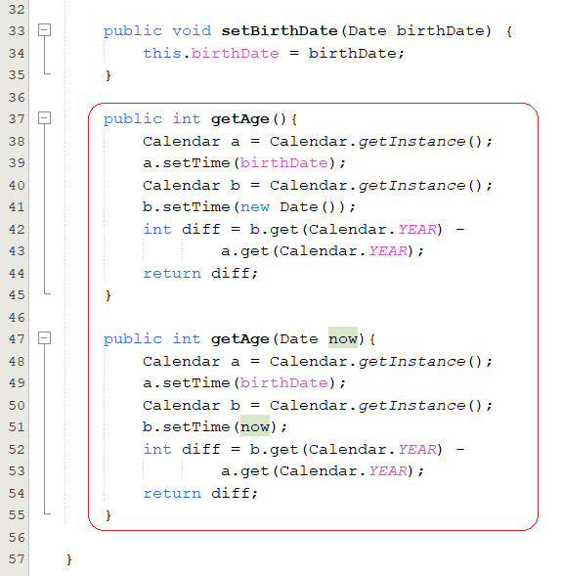
Overloading
Method Overloading is one of the ways that Java implements polymorphism

Slide 11

Before continue to Overriding, lets take a while to study Object class

Slide 12



The Object Class
Java defines one special class called Object that is an implicit superclass of all other classes.
In other words, all other classes are subclasses of Object

Slide 13
Object defines the following methods, which means that they are available in every object
Method | Purpose
Object clone() | Creates a new object that is the same as the object being cloned.
boolean equals(Object obj) | Determines whether one object is equal to another
int hashCode() | Return the hash code associated with the invoking object
String toString() | Return a string that describes the object

Slide 14
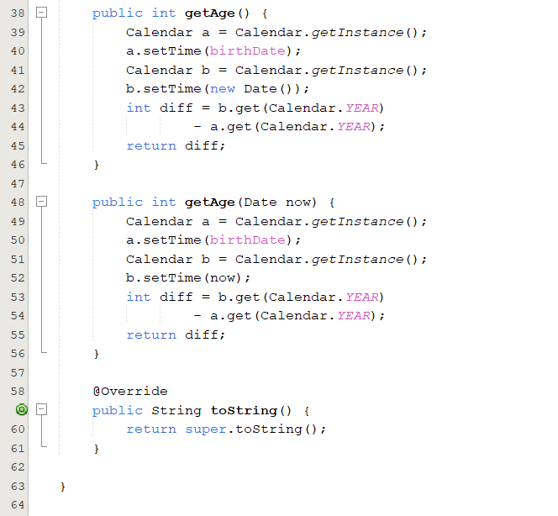
Lets get back to Override and take a look Person class
We can override toString method from Object class in Person class
We can also call toString from it super class using super

Slide 15
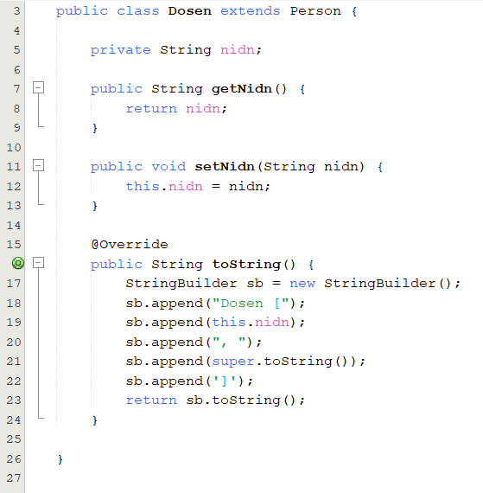
Lets Override toString method in Dosen class
We use StringBuilder here.
If you do String concatenation, then you should use a StringBuilder because it is much faster and consumes less memory.

Slide 16
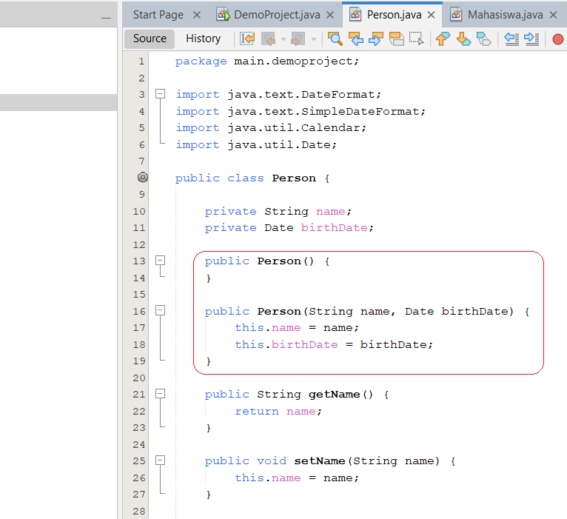
Constructor
A constructor initializes an object when it is created

Slide 17
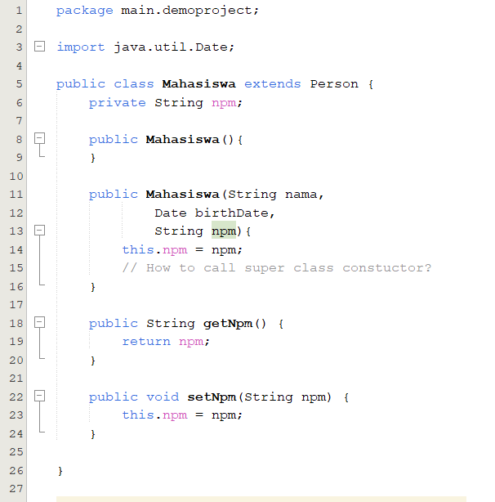
Constructor Overloading
Constructor has the same name as its class and is syntactically similar to a method.
However, constructors have no explicit return type.
Typically, you will use a constructor to give initial values to the instance variables defined by the class, or to perform any other startup procedures required to create a fully formed object.
We can also overload the constructor.

Slide 18
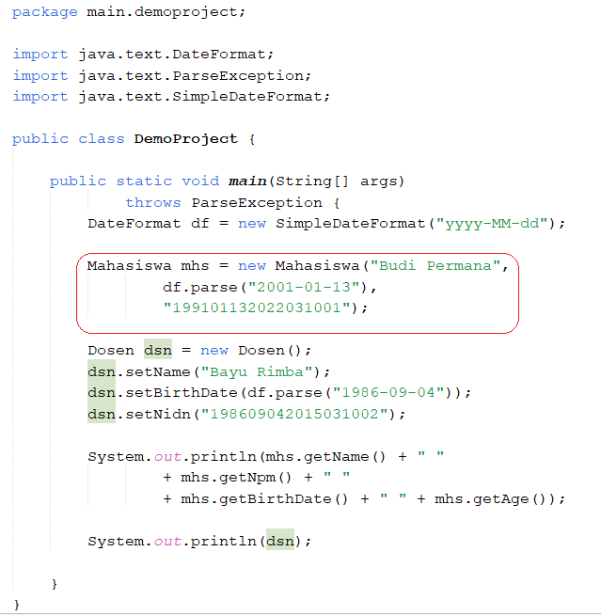
Example usage of constructor

Slide 19
Access Control
 | Class | Package | Subclass | World
public | Y | Y | Y | Y
protected | Y | Y | Y | N
none | Y | Y | N | N
private | Y | N | N | N

Slide 20
Non-Access Control
 | Class | Method | Attribute
final | prevents inheritance | prevents override | prevents change it value, need to be initialized
static | ??? | can be access before any object created | make it global
abstract | make it abstract | make it abstract | not allowed

Slide 21
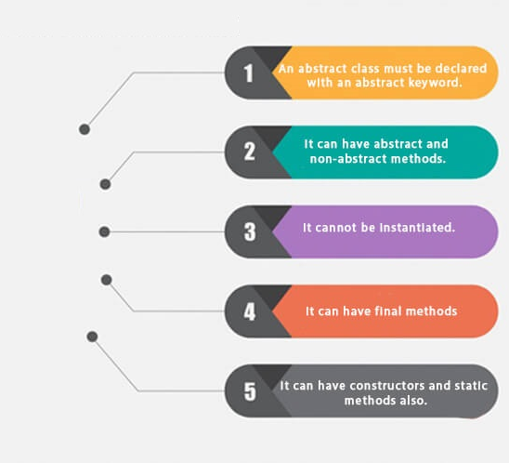
Abstract Class
What is abstract class?

Slide 22
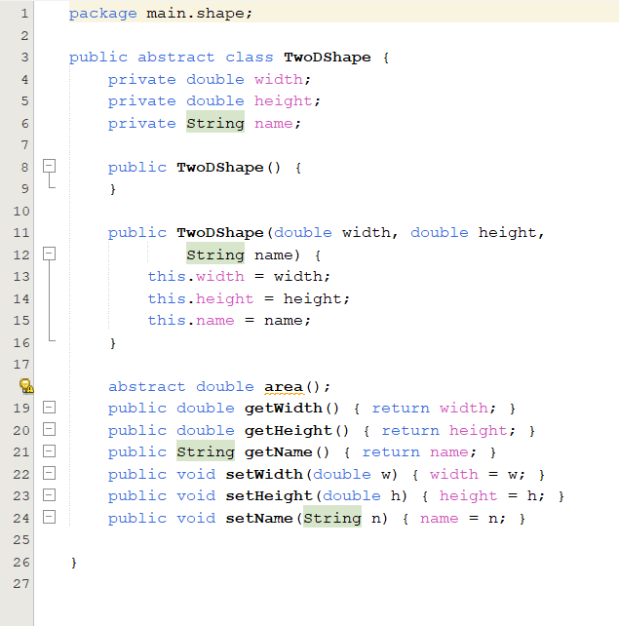
Example Abstract Class
Sometimes you will want to create a superclass that defines only a generalized form that will be shared by all of its subclasses, leaving it to each subclass to fill in the details.
This is the example case of Abstract Class: Two-Dimension Shape.

Slide 23
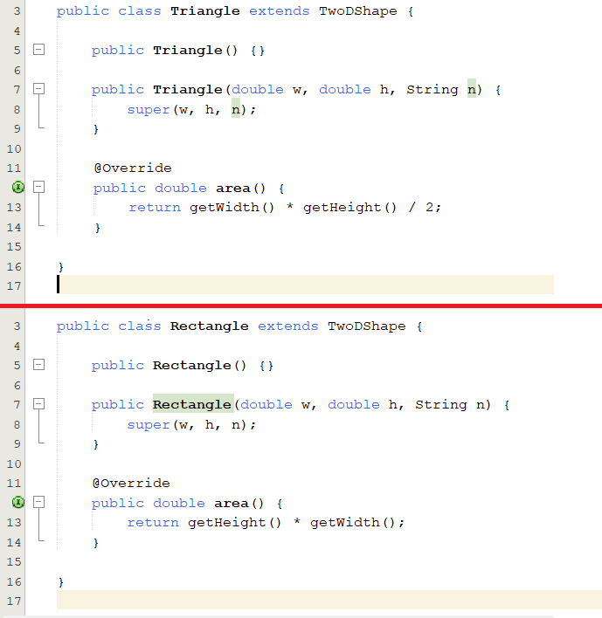
Example Abstract Class
As the program illustrates, all subclasses of TwoDShape must override area().
Only those methods declared as abstract need be overridden by subclasses.

Slide 24

Interface
What is Interface?

Slide 25

A brief story of Interface
In object-­oriented programming, it is sometimes helpful to define what a class must do but not how it will do it. You have already seen an example of this: the abstract method.
An abstract method defines the signature for a method but provides no implementation. A subclass must provide its own implementation of each abstract method defined by its superclass.
Thus, an abstract method specifies the interface to the method but not the implementation

Slide 26
A brief story of Interface
An interface is syntactically similar to an abstract class, in that you can specify one or more methods that have no body.
Those methods must be implemented by a class in order for their actions to be defined.
Thus, an interface specifies what must be done, but not how to do it.
Once an interface is defined, any number of classes can implement it. Also, one class can implement any number of interfaces.

Slide 27
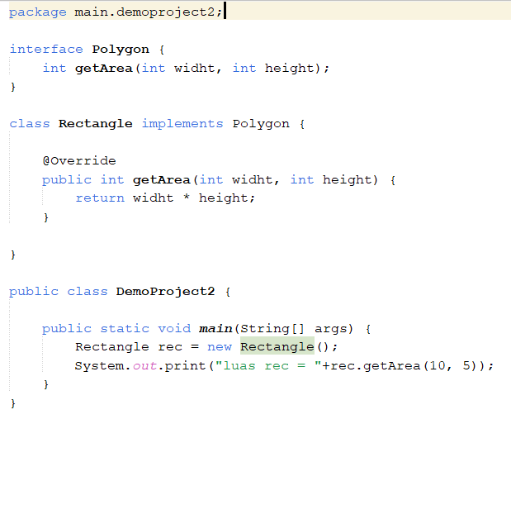
Example Interface

Slide 28

Thank you
Bayu Rimba Pratama, ST, M.Kom
bayurimba@gmail.com
+62 83 100 577 580

